Slide 1

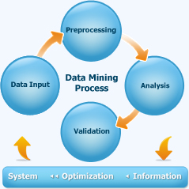
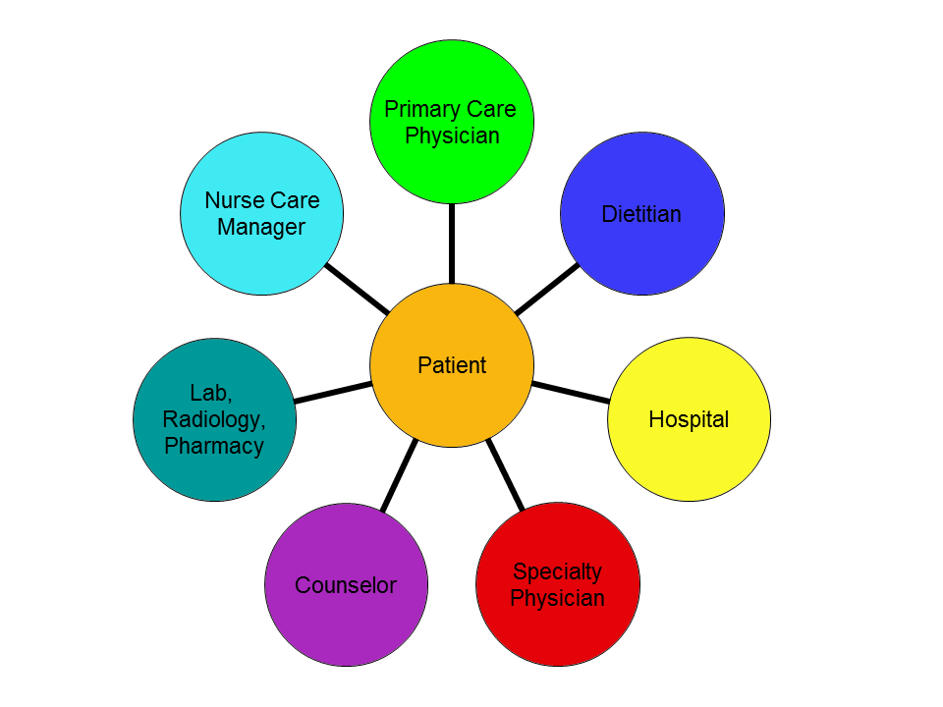

Mining the HealthCare Data with Python
Students: Z. Malcom, T. McDaniel; Advisor: Dr. X. Zhao
Department of Electrical Engineering and Computer Science, Alabama A&M University, Normal, AL 35762
IMPLEMENTATION
CONCLUSION
ABSTRACT
Part 1
Part 2
Data mining is becoming very prominent around the healthcare field in order to provide helpful information for decision makers and practitioners. In this project, the least squares method has been implemented and applied and successfully established the correlation equation between BMI and the patients’ personal attributes based on the dataset from the Center for Disease Control in the first part of the project.
The second part of the project derives the so called “winnable Battle Risk factors and indicators”, the negative behaviors or health risks, from a CDC dataset. The indicators are identified include Heart Disease Death Rate, Motor Vehicle Death Rate, Teen Birth Rate, Adult Smoking, and Adult Obesity. The project successfully identifies the states in US with the best and worst records for each of these indicators, which include: the Max value of Heart Disease Death Rate (2007) is 266.5 from Mississippi; the Max value of Motor Vehicle Death Rate (2009) is 24.62 from Wyoming; the Max value of Teen Birth Rate (2009) is 64.2 from Mississippi; the Max value of Adult Obesity (2010) is 34.50 % from Mississippi; the Max value of Adult Obesity (2010) is 34.50 % from Mississippi . Overall, the dataset shows the patients in Mississippi state had the highest risks in most categories.
Future work will focus on the design and implementation new data mining algorithms to analyze other health care datasets from CDC.
Data mining plays an important role in the healthcare industry to support today’s health systems in order to identify inefficiencies and best practices that improve care and reduce costs. This freshman project is focused on mining two sets of healthcare data from Center for Disease Control (CDC) and consists of two major parts: (1) To analyze the correlation between Body Mass Index (BMI) and patient’s personal attributes, and (2) To analyze five major risk factors closely related to the lifestyle and population heath in different states in US. Both parts employ the programming language Python to implement the data processing.
The first part of the project is the design and implementation of a BMI linear regression model with Python. BMI is the measure based on a person’s weight and height. This project uses a CDC dataset to identify a correlation with a person’s BMI and a combination of physical attributes such as weight, height and age. The least squares method has been implemented and applied and successfully established the correlation equation for data mining.
The second part of the project derives the so called “winnable Battle Risk factors and indicators”, the negative behaviors or health risks, from a CDC dataset. The indicators are identified include Heart Disease Death Rate, Motor Vehicle Death Rate, Teen Birth Rate, Adult Smoking, and Adult Obesity. The project successfully identifies the states in US with the best and worst records for each of these indicators.
import csv
f=open('riskfactors.csv')
csv_f=csv.reader(f)
factor1=[]
factor2=[]
factor3=[]
factor4=[]
factor5=[]
states=[]
for row in csv_f:
states.append(row[0])
factor1.append(row[1])
factor2.append(row[5])
factor3.append(row[7])
factor4.append(row[11])
factor5.append(row[13])
title1=factor1[5]
title2=factor2[5]
title3=factor3[5]
title4=factor4[5]
title5=factor5[5]
del states[0:6]
del factor1[0:6]
del factor2[0:6]
del factor3[0:6]
del factor4[0:6]
del factor5[0:6]
new_factor1=[]
for x in factor1:
new_factor1.append(float(x))
factor1Max=max(new_factor1)
factor1Min=min(new_factor1)
index1=new_factor1.index(factor1Max)
index2=new_factor1.index(factor1Min)
state1=states[index1]
state2=states[index2]
print ("The Max value of ", title1, "is ", factor1Max," from", state1, ".")
print ("The Min value of ", title1, "is ", factor1Min," from", state2, ".")
print ("The Max value of ", title2, "is ", factor2Max," from", state3, ".")
print ("The Min value of ", title2, "is ", factor2Min," from", state4, ".")
print ("The Max value of ", title3, "is ", factor3Max," from", state5, ".")
print ("The Min value of ", title3, "is ", factor3Min," from", state6, ".")
print ("The Max value of ", title4, "is ", factor4Max, "% from", state7, ".")
print ("The Min value of ", title4, "is ", factor4Min, "% from", state8, ".")
print ("The Max value of ", title5, "is ", factor5Max, "% from", state9, ".")
print ("The Min value of ", title5, "is ", factor5Min, "% from", state10, ".")
f=open ('body.dat')
mydict={}
for line in f:
age=line[110:114]
weight=line[115:120]
height=line[121:126]
print(age,' ',weight,' ',height)
bmi=float(weight)*100*100/(float(height)*float(height))
print(bmi)
mydict[age]=bmi
print('mydict is:')
print(mydict.items())
sumX=0
for key in mydict:
sumX=sumX+float(key)
print('sumX is:', sumX)
sumY=0
for y in mydict:
sumY=sumY+float(mydict[y])
print('sumY is:', sumY)
sumXY=0
for x in mydict:
sumXY=sumXY+ float(x)*float(mydict[x])
print('sumXY is:', sumXY)
sumX2=0
for x in mydict:
sumX2=sumX2+ float(x)**2
print('sumX2 is:', sumX2)
sumY2=0
for y in mydict:
sumY2=sumY2+float(mydict[y])**2
slope=((len(mydict)*sumXY)-(sumX*sumY))/((len(mydict)*sumX2)-(sumX**2))
print('The slope is:', slope)
intercept=(sumY-(slope*sumX))/len(mydict)
print('The y-axis intercept is:', intercept)
import math
corr=((len(mydict)*sumXY)-(sumX*sumY))/math.sqrt((len(mydict)*sumX2-(sumX**2))*(len(mydict)*sumY2-(sumY**2)))
print('The coorelation is:', corr)
RESULTS PART 1
The parameters for the linear regression model:
The slope is: 0.05767949178969901.
The y-axis intercept is: 21.33804954470096.
The correlation between the patient’s BMI and age is: 0.2108388342474396
RESULTS PART 2
REFERENCES
1. Obenshain, M., 2004, “Application of Data Mining Techniques to Healthcare Data”, Infection Control and Hospital Epidemiology, pp690-695.
2. Kob, H. and G. Tan, 2011, “Data Mining Applications in Healthcare”, Journal of Healthcare Information Management, Vol. 19, No. 2, pp64-72.
3. Srinivas, K., Rani, B. Govrdhan, A., 2010, “Applications of Data Mining Techniques in Healthcare and Prediction of Heart Attacks”, International Journal on Computer Science and Engineering, Vol. 02, No. 2, pp250-255.
4. Downey, A., 2015, Think Python, Second Edition
(ISBN 978-1491939369), http://greenteapress.com/wp/think-python-2e/
The Max value of Heart Disease Death Rate (2007) is 266.5 from Mississippi .
The Min value of Heart Disease Death Rate (2007) is 129.8 from Minnesota .
The Max value of Motor Vehicle Death Rate (2009) is 24.62 from Wyoming .
The Min value of Motor Vehicle Death Rate (2009) is 4.84 from District of Columbia .
The Max value of Teen Birth Rate (2009) is 64.2 from Mississippi .
The Min value of Teen Birth Rate (2009) is 16.4 from New Hampshire .
The Max value of Adult Smoking (2010) is 9.10 % from Utah .
The Min value of Adult Smoking (2010) is 12.10 % from California .
The Max value of Adult Obesity (2010) is 34.50 % from Mississippi .
The Min value of Adult Obesity (2010) is 21.40 % from Colorado .
INTRODUCTION
Data Mining has become very popular and almost a necessity in the healthcare field. Data mining is the process of finding previous unknown patterns and trends in datasets in order to create predictive models. One of the reasons that data mining has become so popular is that healthcare data has become too complex to be analyzed by traditional practices. Data mining was used in both parts of the project and clearly made the results drastically easier to produce opposed to traditional practices. Data mining will continue to be a very important practice and will continue to influence the cost, revenue, and operating cost of healthcare organizations.
EXPERIMENTAL SETUP
We used several tools during this project. We used a data file of 507 individuals and their physical attributes for the first half of this project. Then we used the winnable battle risk factors and health indicators report from the Centers for Disease Control(CDC) as our means of data for the second half of this project. The programming language we used to write the code to perform the tasks presented was Python. The program was tested in Python 3.4 IDLE for Windows.
ACKNOWLEDGEMENTS
This project is sponsored by the Department of Education MSEIP grant at Alabama A&M University.

